Slide 1

GROUP-02: EEE-299: JUNIOR DESIGN PROJECT
SMART CAR PARKING SYSTEM
NAME | ID
Anan Faiyaz Radin | 1931714643
Kazi Ejaj Hossain | 1931311043
Ashraf Uddin Opu | 1931087043
Meher Nigar Abila | 1931138043

Slide 2

INTRODUCTION & MOTIVATION
SMART PARKING
AUTOMATIC, FLEXIBLE TECHNOLOGY
TIME SAVING
CHECK-IN & OUT TIME
UPDATE
HASSLESS PARKING
CURRENT LOCATION OF VEHICLE
COST EFFECTIVE
LESS TROUBLE
WELL ORGANIZE
ENVIRONMENT FRIENDLY
REDUCE TRAFFIC

Slide 3
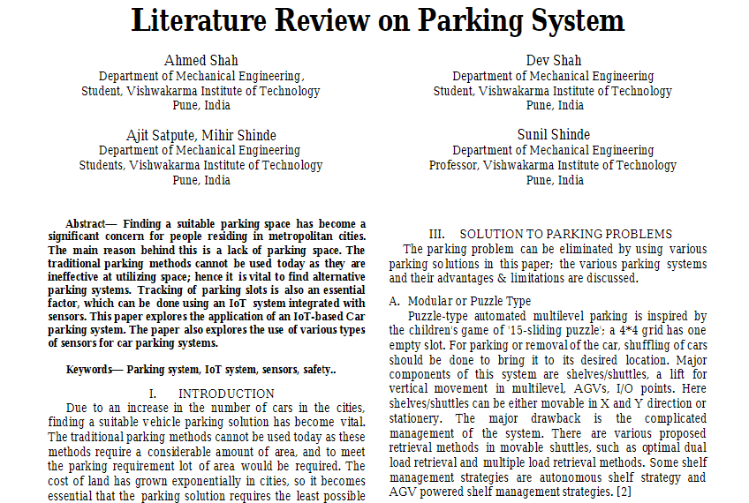
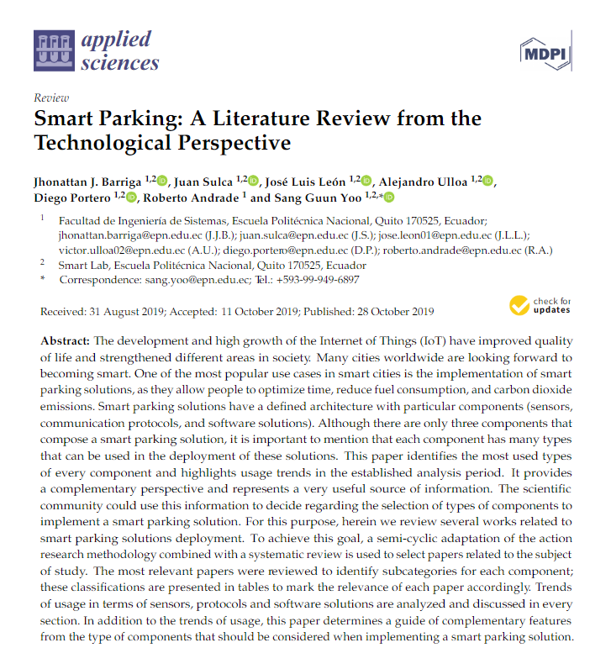
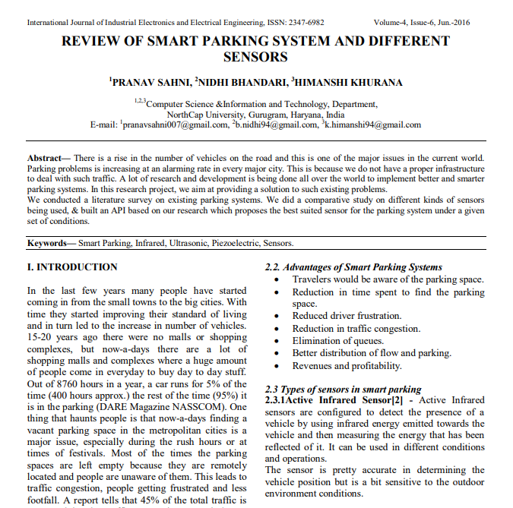
LITERATURE REVIEW

Slide 4
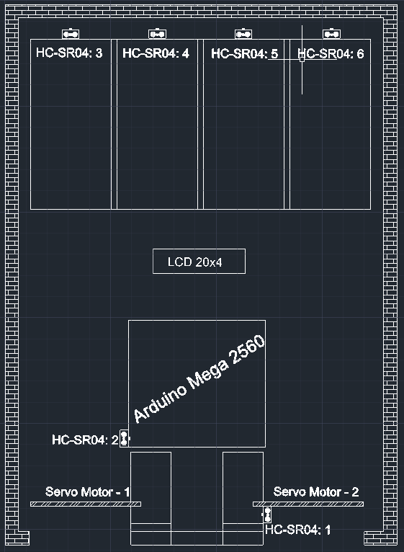
COMPONENTS
ARDUINO MEGA - 2560 - 1
ULTRASONIC SENSOR - 6
(HC-SR04)
SERVO MOTOR - 2
(SG-90)
I2C & LCD DISPLAY 20X4 - 1
JUMPER CABLES

Slide 5
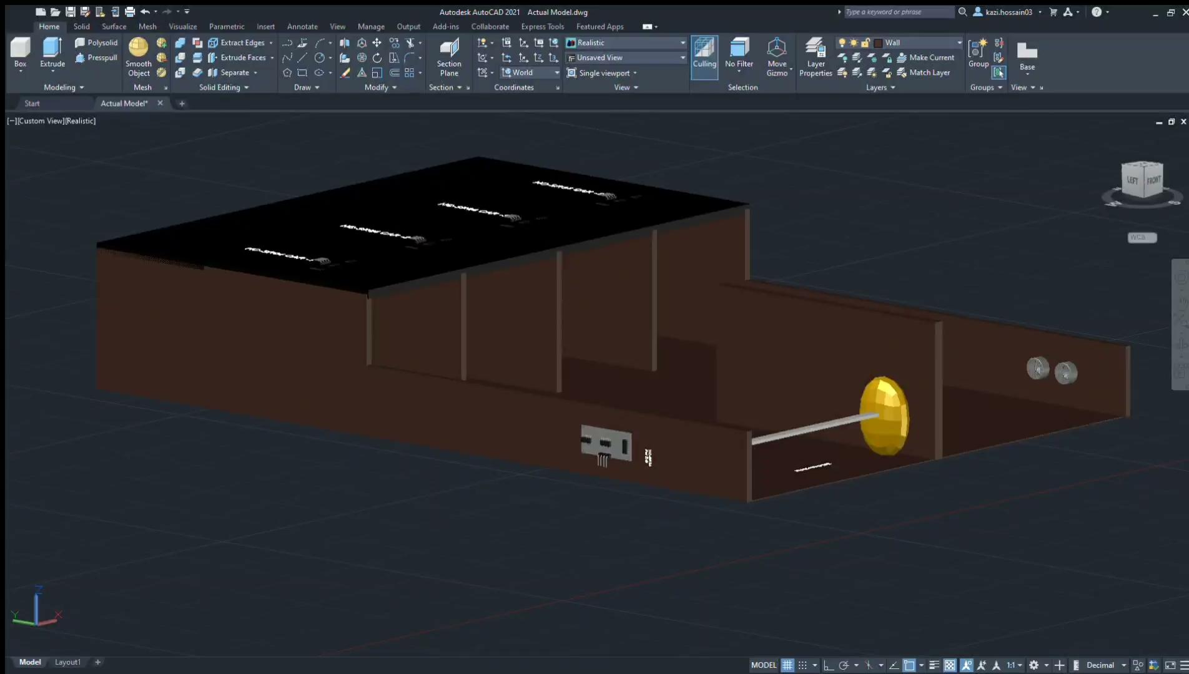
MODEL DESIGN

Slide 6
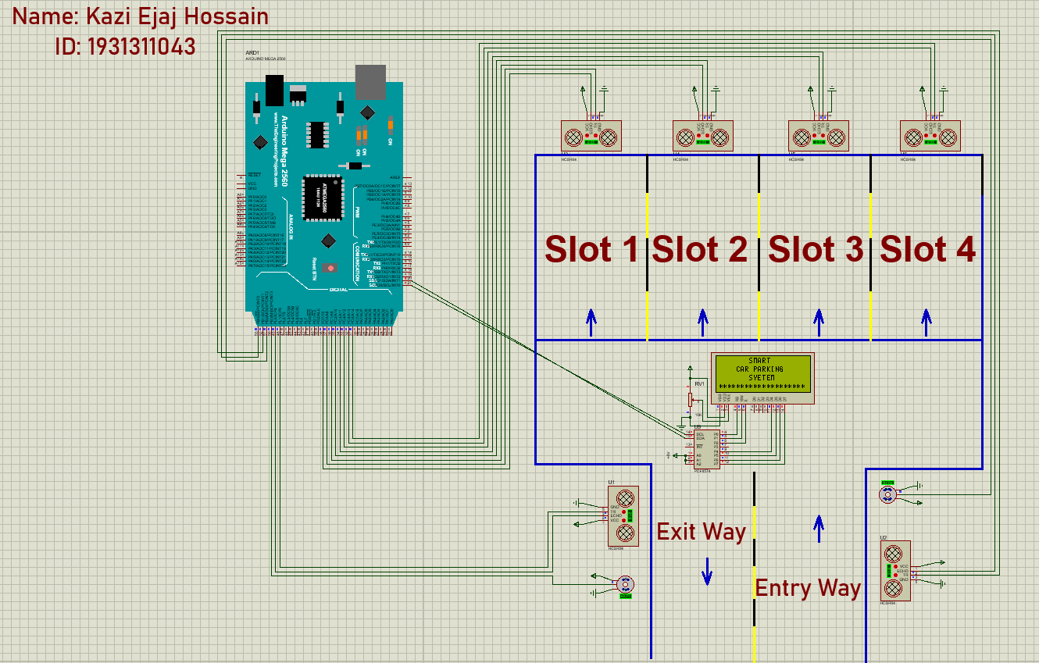
CIRCUIT DIAGRAM

Slide 7
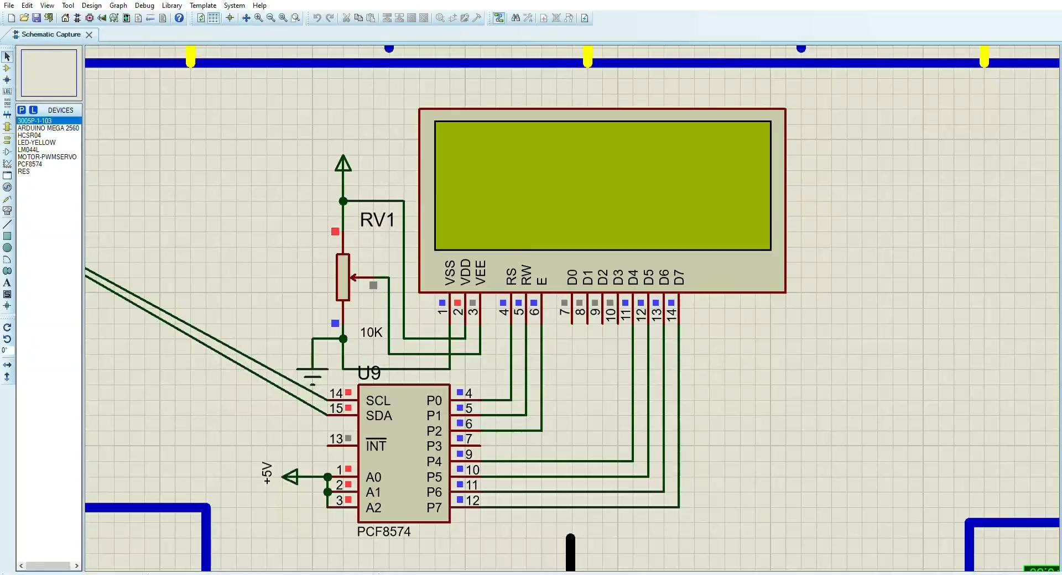
SIMULATION

Slide 8
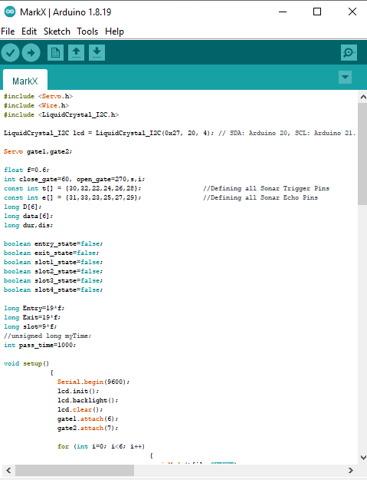
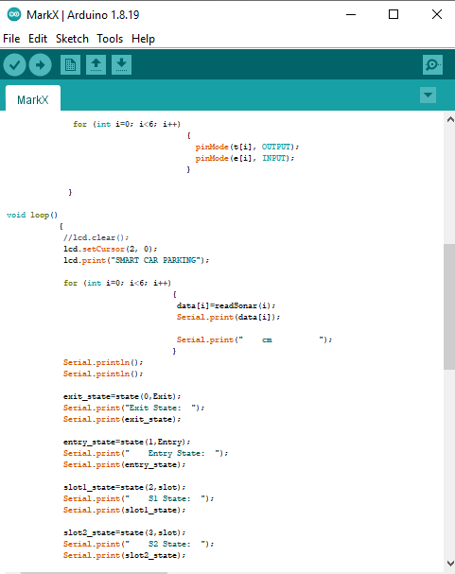
CODING

Slide 9
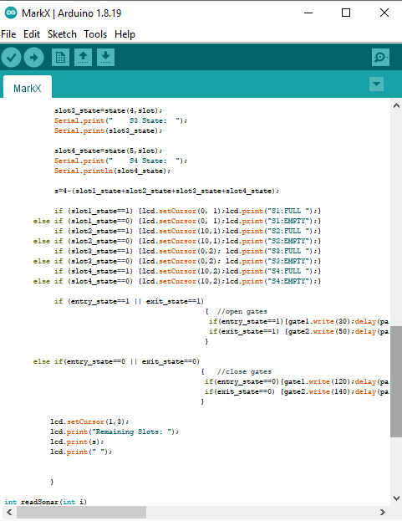
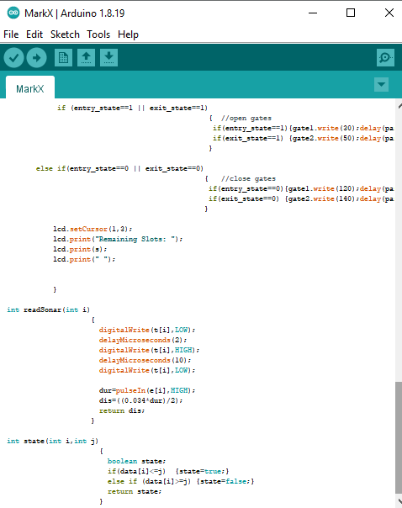
CODING

Slide 10
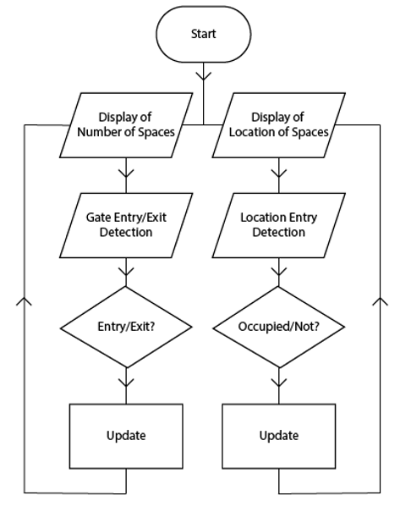
FLOWCHART

Slide 11
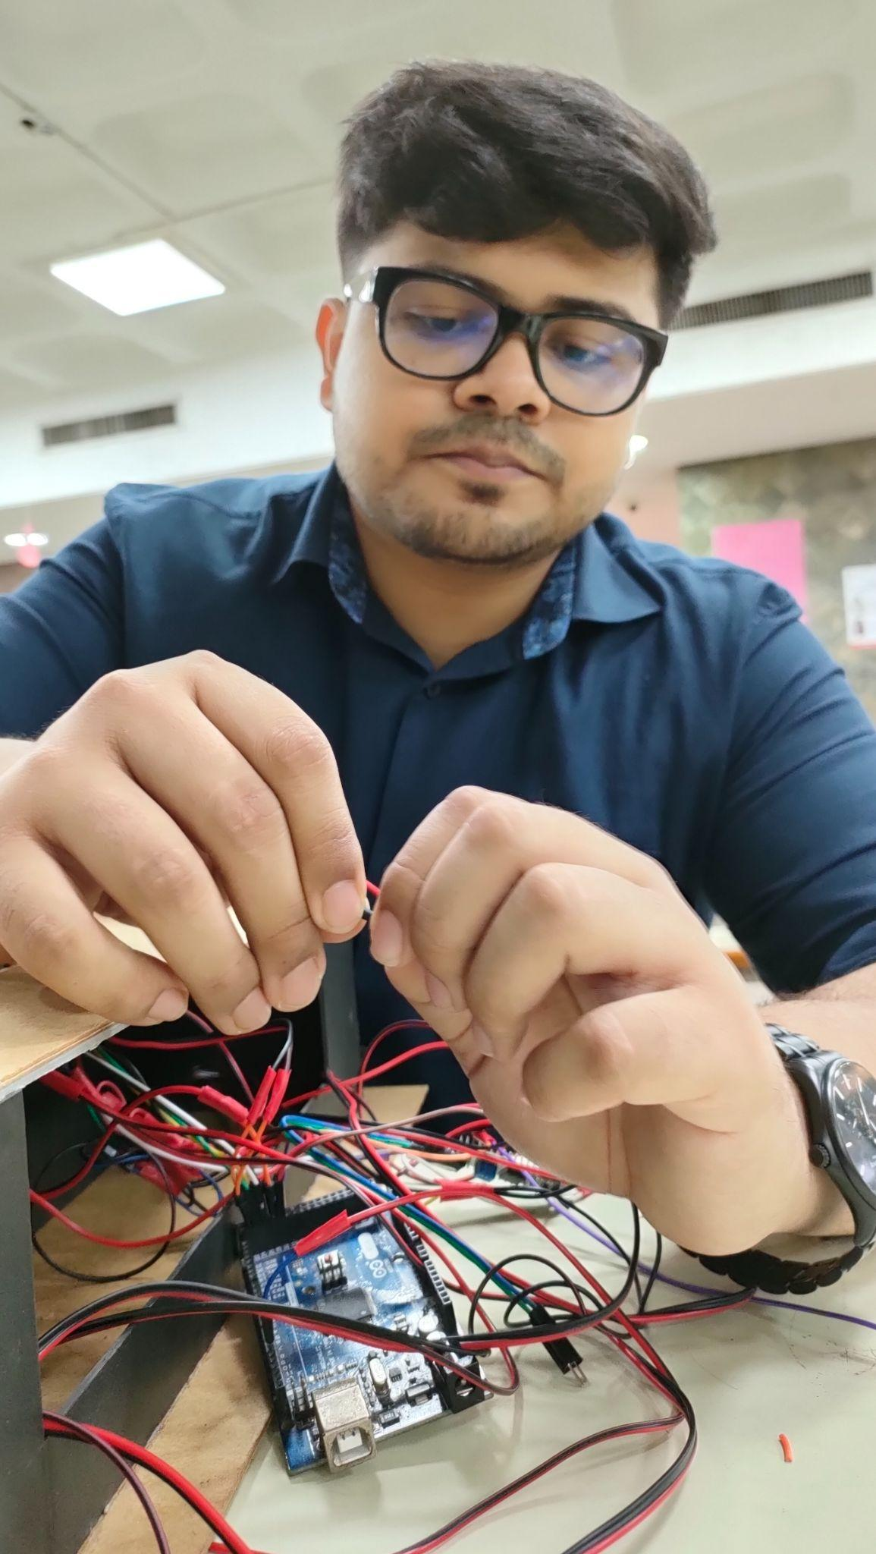
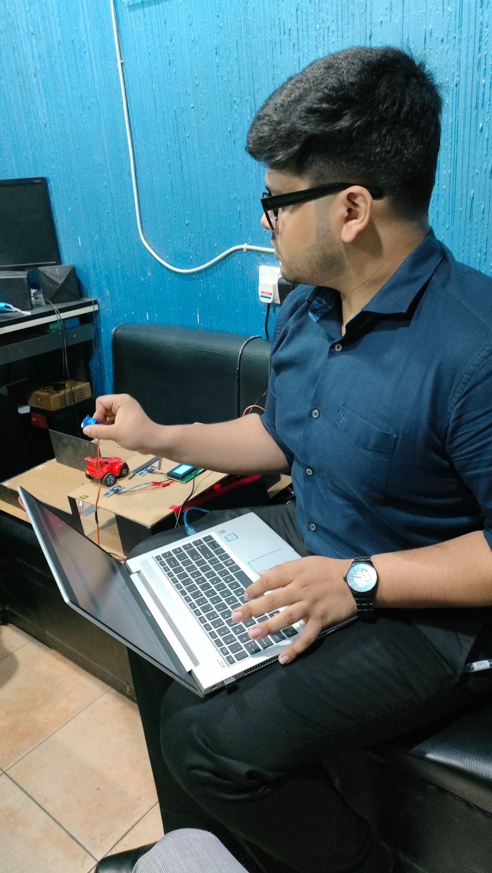
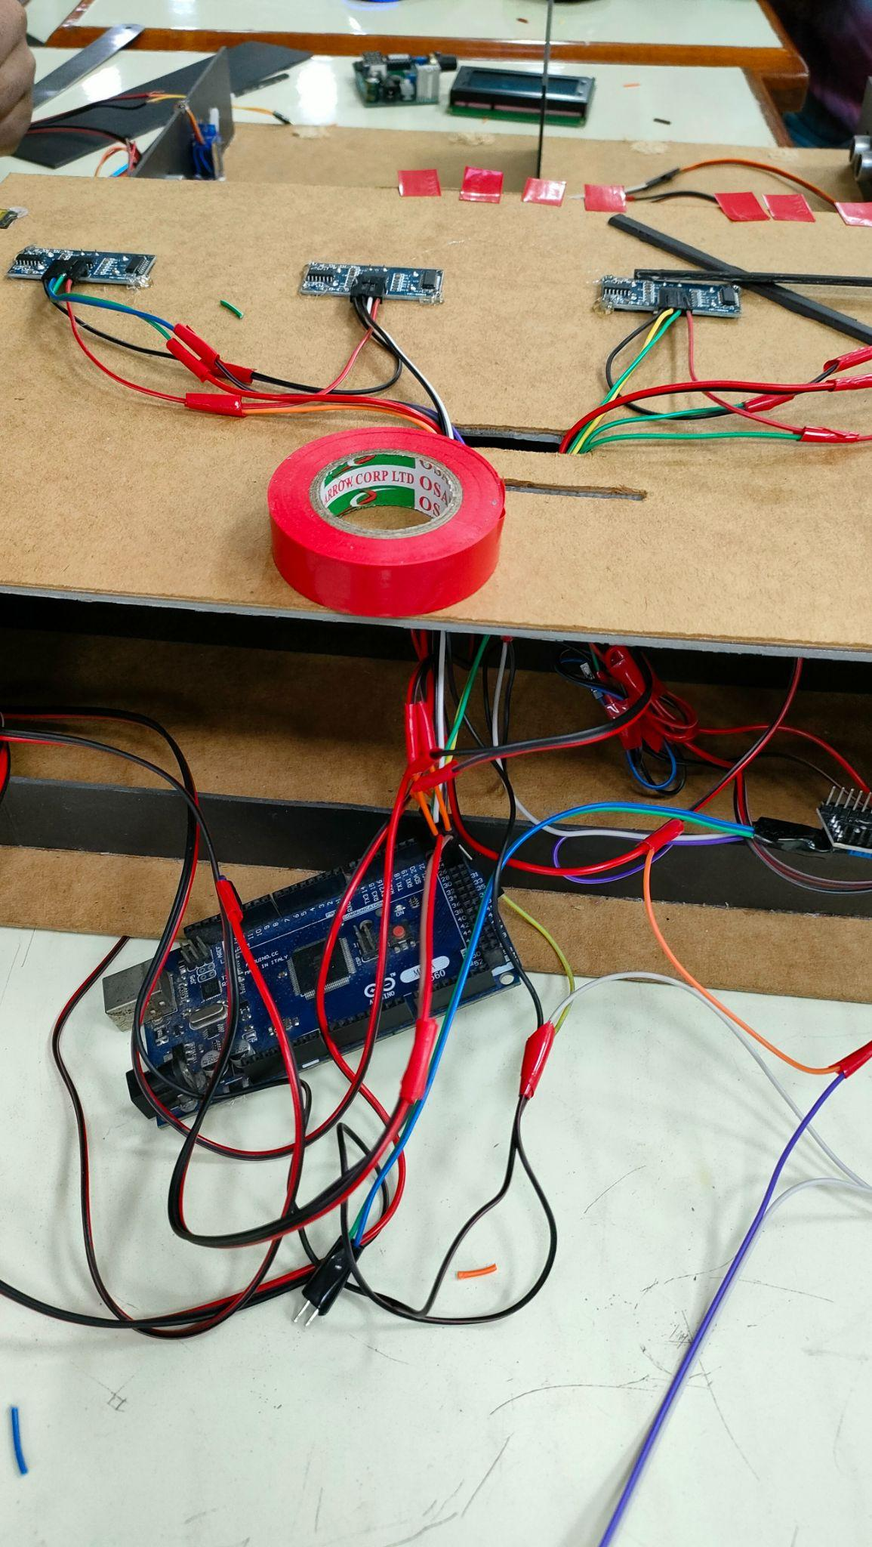
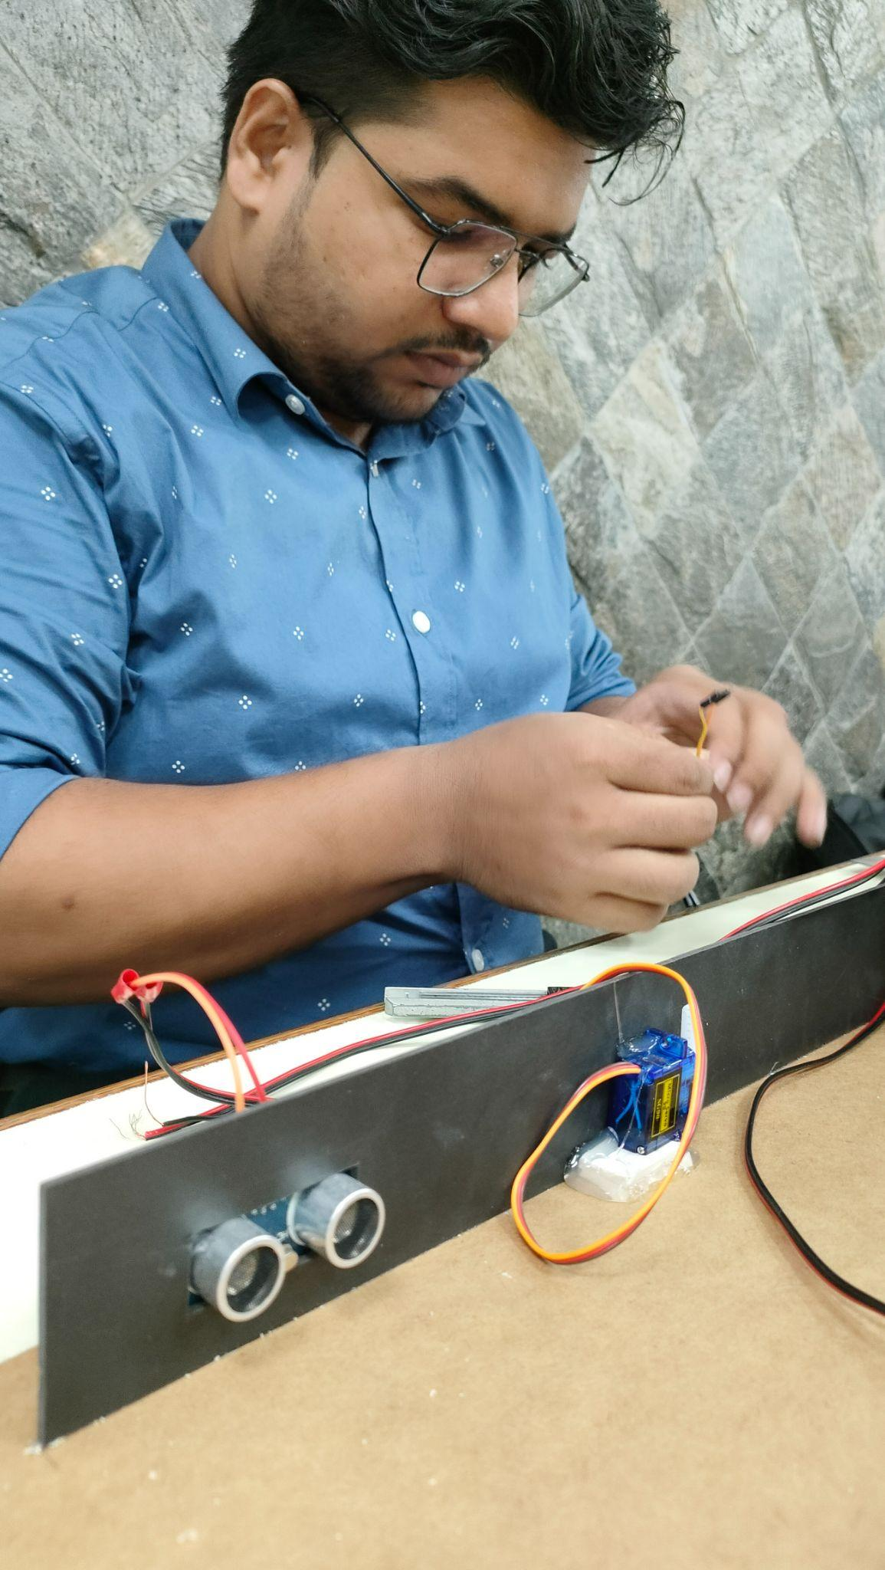
HARDWARE IMPLEMENTATION

Slide 12
DEMONSTRATION

Slide 13
TROUBLESHOOTING
01
SENSOR
SERVO-MOTOR
02
03
WIRING
04
CODING
05
DISPLAY

Slide 14
FURTHER IMPROVEMENT
Increase Capacity
Develop Wireless Sensor Modules
Use Better Quality Display
Develop Algorithm
IOT Based Model

Slide 15
CONCLUSION
1
PARKING ADVANCEMENT
FAMILIARIZATION WITH ARDUINO
INTERACTION BETWEEN ALL THE
COMPONENTS
SAVING TIME
2
SIMULATION, DRAWING AND CODING
3
REDUCE TRAFFIC
PROBLEM FACING & SOLVING
DESIRED GOAL ACHIEVEMENT

Slide 16
THANK YOU
https://docs.google.com/presentation/d/1UaKq_HY1b-NDDwP1fq_-OOHWNldcJzv82Ft8gtrdmFQ/edit?fbclid=IwAR0KMr8yOijqdrsTfdjwIGgzfabQrOR9my1fd0vZboLvGZM-MrKEWiDZ0_I&pli=1#slide=id.g1143f9e4fd9_0_1490

